Slide 1
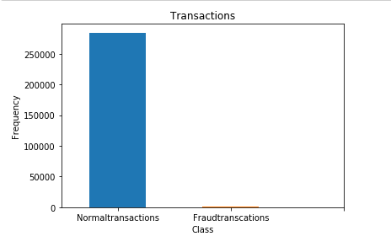
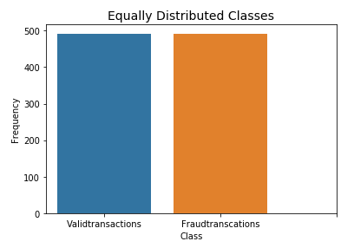
Fraud Detection using Classification
Amena Afreen CS Hood College aa24@hood.edu
Abstract
Dataset Preprocessing
Results:
Anomaly detection is the key for the future data mining. It is a data mining technique which allows us to find patterns in data that do not conform to expected behavior. In a world where technology is advancing at abnormal rate, credit cards are playing a vital role in today’s economy. It is used everywhere such as in household, business and global activities. There are quite many benefits of using credit cards. Credit cards should be used legally but the illegal usage of it might lead to fraudulent activities and cause several damages. Fraudulent activities take place in every field of financial domain, credit card transactions are also sometimes fraudulent. Due to the widespread usage of credit card, there is an increase in credit card frauds. The credit card fraud detection dataset is highly skewed and imbalanced, so we first balance the dataset by equally distributing the frauds using some random sampling. The project aims detecting the fraudulent transactions by training the dataset and applying different classification models to predict the fraudulent behavior of the transactions.
The credit card fraud dataset is from a European credit card company and is obtained from Kaggle. The transactions are done in 2013 September. The transaction history of the two days is shown in the dataset. The dataset is highly imbalanced, which means that the number of observations that belong to one class are higher than the observations belonging to other class. The total number of transactions in the dataset are 284,807 out of which 492 transactions are termed as fraud which is accounted as 0.172% of whole transactions. Due to confidentiality, the input variables are converted to numerical values by PCA transformation, the features V1,V2,., V28 are the principal components obtained from PCA and thus are not the original features. Feature Time represents the difference in the seconds between the particular transaction and the first transaction. ‘Amount’ is the amount of money for which the transaction has taken place. Feature ‘Class’ is the label that shows whether a transaction is fraud or not. The data labels indicate that the data point is anomalous or normal. When we plot time against the transaction, no abnormal behavior is shown. The columns “Time” and “Amount” are not scaled by PCA, so they should be scaled. We first determine that how imbalanced the dataset is, we tend to resample the data by using random sampling distributions so that there are equal number of fraud and valid transactions.
figure 1, 2
Nearest Neighbor
Train/Test Model | Accuracy | F1 Score | Precision | Recall
Train | 0.95% | 0.95% | 0.97% | 0.93%
Test | 0.92% | 0.93% | 0.98% | 0.88%
Support Vector Machines
Train/Test Model | Accuracy | F1 Score | Precision | Recall
Train | 0.95% | 0.94% | 0.98% | 0.91%
Test | 0.93% | 0.94% | 0.98% | 0.90%
Logistic Regressor
Train/Test Model | Accuracy | F1 Score | Precision | Recall
Train | 0.94% | 0.94% | 0.97% | 0.91%
Test | 0.93% | 0.94% | 0.98% | 0.90%
Introduction
Conclusion
The fraud detection model is trained using the European credit card fraud data. The credit card fraud detection model using Support Vector Machines, K-Nearest Neighbor and Logistic Regression for credit card fraud detection has been successfully implemented. The accuracy scores, for all the three classifiers turned out to be outstanding.
Datamining is about discovering insights from data that are statistically reliable, unknown previously and actionable (Elkan, 2001). The data must be available, and it should be clean to work on. The word “fraud” refers to the abuse of a profit organization’s system without necessarily leading to direct legal significances. In an environment where there are competitions emerging, there are chances that fraud can become a critical problem if it is widespread and if the procedures undertaken for prevention are not fail-safe. One of the important parts of fraud control is “Fraud Detection”, it automates and helps reduce the manual parts of screening/checking process.
Fraud detection has become one of the most reputable applications of data mining. The occurrence of anomalous behavior is not seen frequently, if they occur frequently then the consequences are negative. The advancement of e-commerce led to convenience in using credit cards and has become necessary for financial life. Fraud is increasing drastically with globalization and modern technology which results in major loss to the business.
When a credit card is used illegally without the knowledge of owner of the card then it is referred to as credit card fraud. There are two groups of frauds basically application fraud and behavioral fraud. Application fraud is a type of fraud where fraudsters apply new cards from bank using false identity. On the other hand, behavioral fraud is of four types such as stolen/lost, counterfeit card, mail theft and card holder not present.
The patterns of text in a dataset that do not conform to a normal behavior are termed as anomalies. These are the behaviors that are previously not known. Anomaly Detection is a technique used to find these patterns in the dataset. The data has two normal regions, N1 and N2, since most observations lie in these two regions. Points that are away from these regions or areas, such as the points o1 and o2, and points in region o3, are anomalies.
When a single data point can be considered as anomalous with respect to the rest of data, then the point is called point anomaly. When a data point is anomalous in a specific context, then it is termed as contextual anomaly. It comprises of contextual attributes and behavioral attributes. A collection of related data instance is anomalous with respect to the entire dataset, it is termed as collective anomaly. The unique data instances in a collective anomaly may not be anomalies.
Methodology
1. Density Based Anomaly Detection
In Density-based anomaly detection density of the neighborhood of each data instance is estimated. An instance is said to be anomalous when its density is low, and it is said to be normal when it lies in dense neighborhood. For any instance, the distance to its Kth nearest neighbor is equivalent to the radius of hypersphere.
2. K-Nearest Neighbor
Nearest-Neighbor based fraud detection there needs to be some distance or any similar measure between two data points. K-Nearest Neighbor is a supervised learning algorithm. It requires valid as well as fraudulent samples of the data for training.
3. Logistic Regression
Logistic Regression is used for different classification problems such as fraud detection, diabetes prediction, school grade prediction. In this one can draw some possible hyperplanes between the two classes. The idea that lies behind SVM is to derive a unique separating hyperplane that maximizes the separating margin between the two classes.
References:
[1] Machine Learning Group. 2018. Credit Card Fraud Detection. (March 2018). Retrieved December 20, 2018 from https://www.kaggle.com/mlg-ulb/creditcardfraud
[2] Varun Chandola, Arindam Banerjee, and Vipin Kumar. 2016. Anomaly Detection. Encyclopedia of Machine Learning and Data Mining (2016), 1–15. DOI:http://dx.doi.org/10.1007/978-1-4899-7502-7_912-1
[3] Roberto Marmo. Data Mining for Fraud Detection System. Encyclopedia of Data Warehousing and Mining, Second Edition, 411–416. DOI:http://dx.doi.org/10.4018/978-1-60566-010-3.ch065
[4] Victoria Hodge and Jim Austin. 2004. A Survey of Outlier Detection Methodologies. Artificial Intelligence Review 22, 2 (2004), 85–126. DOI:http://dx.doi.org/10.1023/b:aire.0000045502.10941.a9
[5] Roberto Marmo. Data Mining for Fraud Detection System. Encyclopedia of Data Warehousing and Mining, Second Edition, 411–416. DOI:http://dx.doi.org/10.4018/978-1-60566-010-3.ch065

